Slide 1

DEVI AHILYA VISHVWAVIDYALAYA, INDORE
SCHOOL OF STATISTICS
SESSION 2021-23
GUIDED BY :-
Dr. Snigdha Banerjee
Head of Department
School of Statistics
SUBMITTED BY :-
Shreya Agrawal
M.Sc 3rd Sem

Slide 2
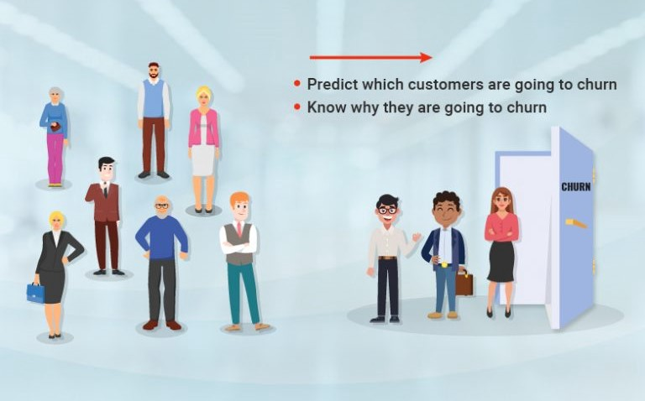

Slide 3
Objective :-
Objective of this study is to identify various factors responsible for churning. To deal with bulk of data and to pick out handful of variables responsible for churning along with that it is our goal to determine the enumerate the extent of contribution of different factors which are responsible for churning . Their might be some factors which are not important to all this churning process so our focus would also be on to dust away those factors.
Motivation of the study :-
Banking is an integral part of the whole financial system. It affects the country’s economy by providing investment, credit, and infrastructure. But nowadays banks are suffering losses due to frauds, multiple options to invest and majorly due to churning . This as whole is affecting economy of our country , which should be major concern for all. Moreover, it should be noted that monitoring churn should be a constant concern of any company today, regardless of its industry, as competition is fierce and the digital age has made it easier for customers to move their business elsewhere if so is desired. It is, therefore, in the best interest of any company to keep track of the behavior of its customers in order to potentially anticipate any signs of dissatisfaction that could eventually lead to churning

Slide 4
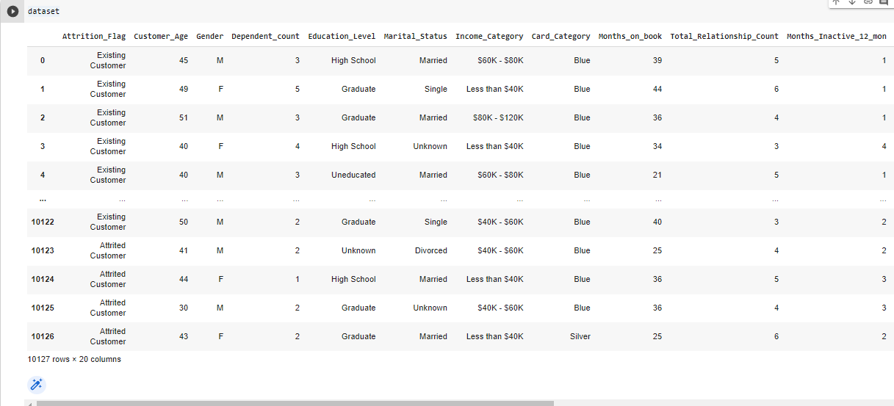
Dataset

Slide 5
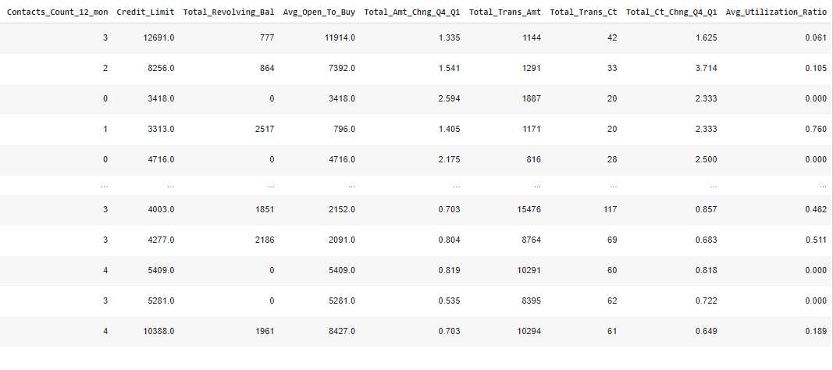

Slide 6
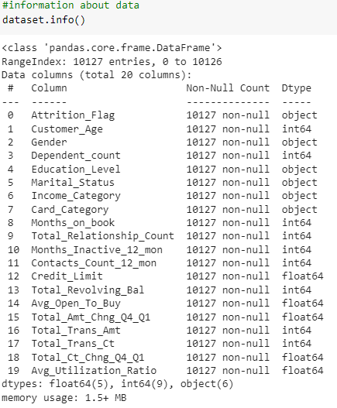
Exploratory Data Analysis (EDA)
Exploratory Data Analysis is to uncover the underlying structure. The structure of the various data sets determines the trends, patterns, and relationships among them.
Importance of using EDA for analyzing data sets is:
Helps identify errors in data sets.
Gives a better understanding of the data set.
Helps detect outliers or anomalous events.
Helps understand data set variables and the relationship among them.

Slide 7
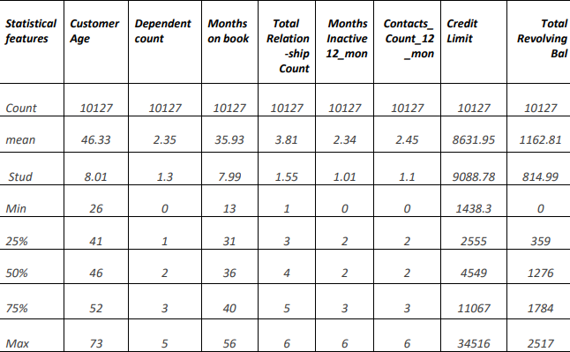
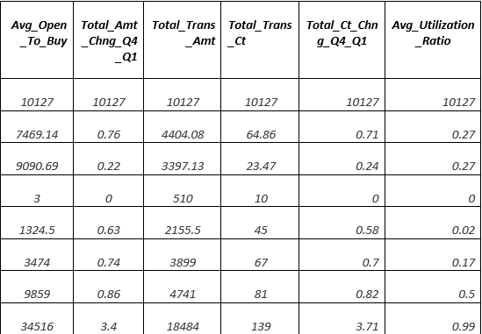
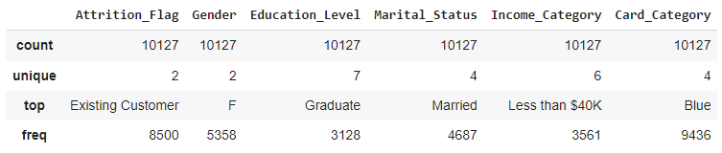
Statistical description for all numerical variable:-
Statistical description for all Categorical Variable:-

Slide 8
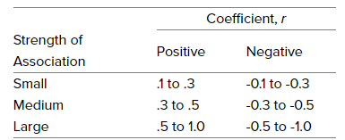
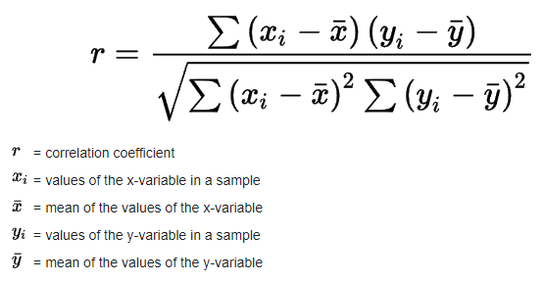
Correlation test –
The strength of the association between two variables is known as the correlation test.
Pearson correlation coefficient:-
Pearson correlation quantifies the
linear relationship between two variables.

Slide 9
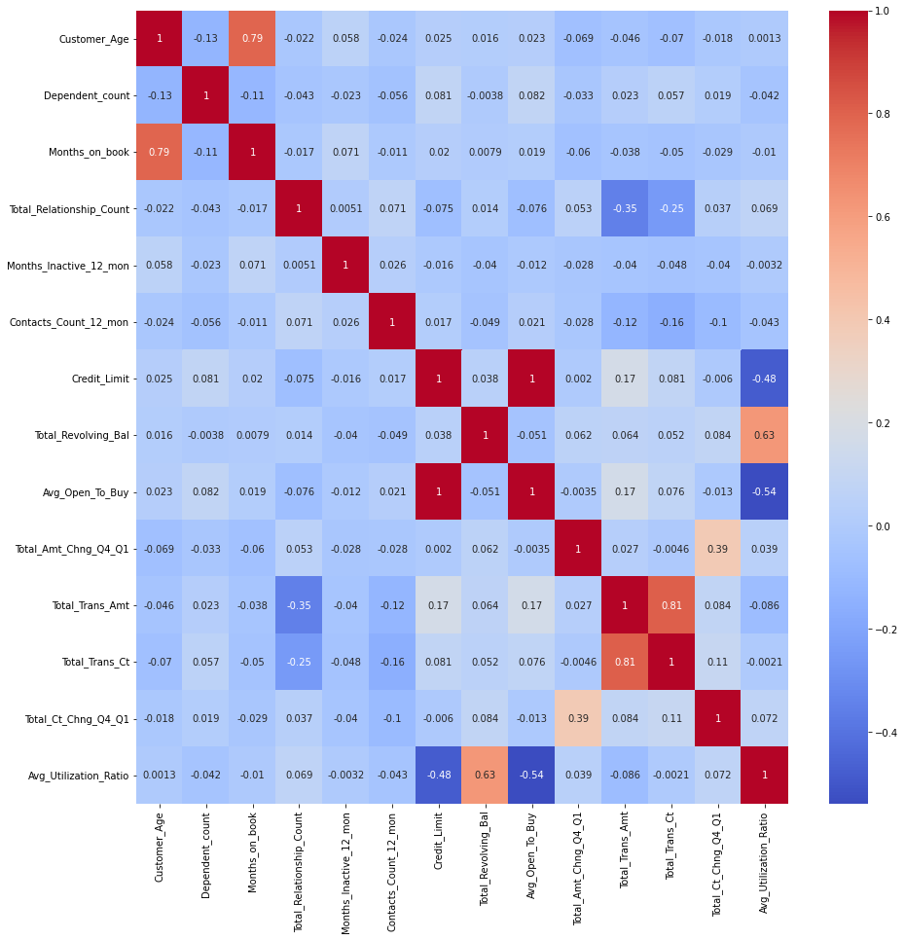
Correlation Heatmap:
Correlation Heatmaps are a type of plot that visualize the strength of relationships between numerical variables
Conclusion:
1) There is a perfectly positive correlation between Credit Limit and Avg_Open_to_Buy.
2) There is a strong positive Correlation between the pair of Total_Trans_Ct & Total_Trans_Amt and Customer Age and Month_on_book.
3) Most of the variables have nearly no correlation with other variables.

Slide 10
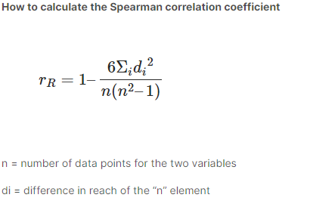
Spearman Correlation-
Spearman correlation is a non-parametric correlation measure using for all type of data.
The Spearman coefficient, p, can have a value between +1 and -1 where:
p=+1 → It means a perfect classification association.
p=0 → It means that there is no classification association.
p=-1 → It means a perfect negative association between the intervals.

Slide 11
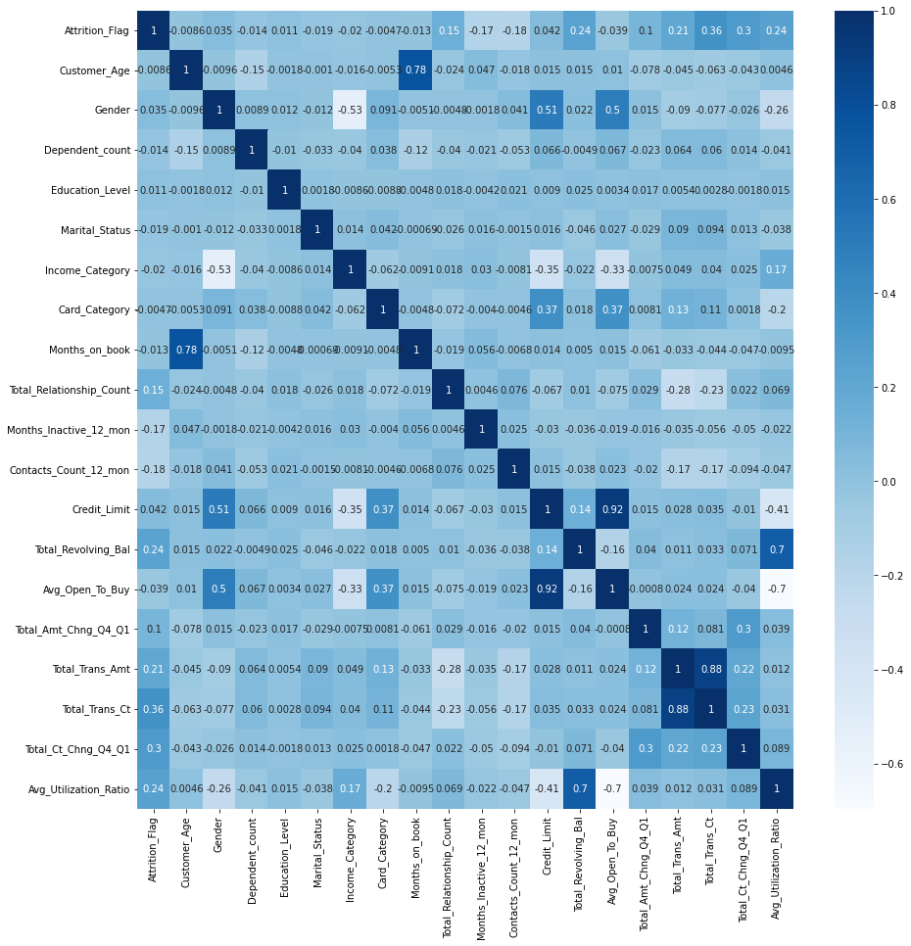
Heatmap for Spearman Correlation:
Heatmaps for Spearman Correlation are a type of plot that visualize the strength of relationships between all the variables
Conclusion:
There is a Strong Positive Association between the pairs of Credit Limit & Avg_Open_to_Buy, Total_Trans_Ct & Total_Trans_Amt and Customer Age & Month_on_book.
Most of the variables have nearly no Association with other variables

Slide 12
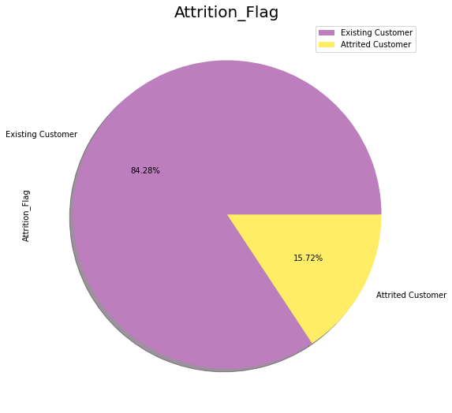
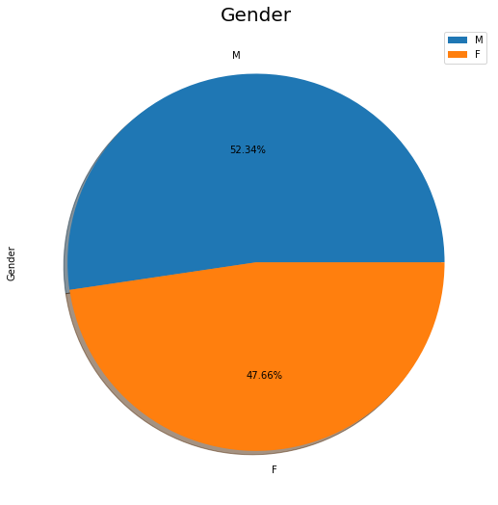
EDA on all categorical Variable:
In Attrition_Flag variable which is a target variable, there are
Attrited Customers of a Bank are 16%
Existing Customers of a Bank are 84%
In Gender, There are
Male Customers in Bank are 52.34%
Female Customers in Bank are 47.66%

Slide 13
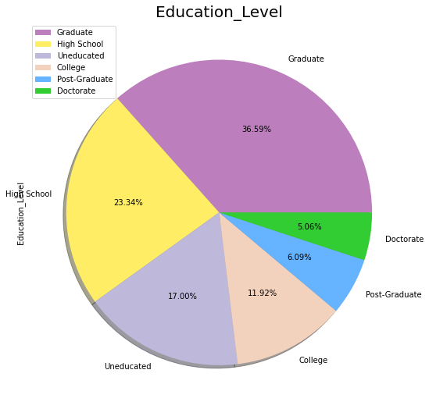
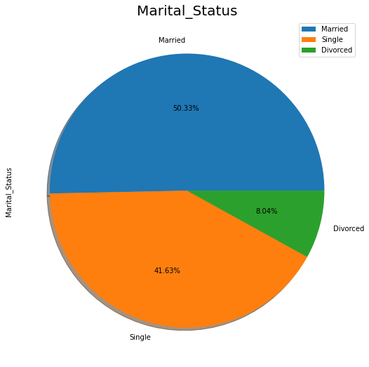
In Education_level, There are
Uneducated Customers in Bank are 17.00%
High School Customers in Bank are 23.34%
College Customers in Bank are 11.92%
Graduate Customers in Bank are 36.59%
Post Graduate Customers in Bank are 6.09%
Doctorate Customers in Bank are 5.06%
In Marital Status, There are
Married Customers in Bank are 50.33%
Single Customers in Bank are 41.63%
Divorced Customers in Bank are 8.04%

Slide 14
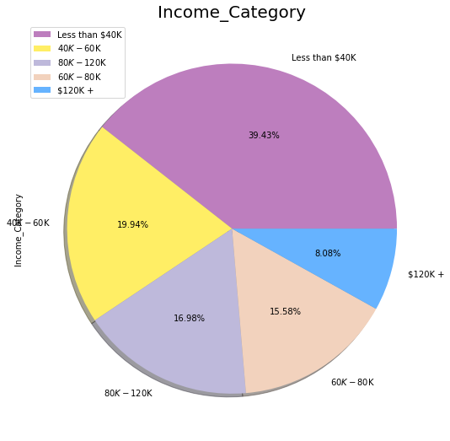
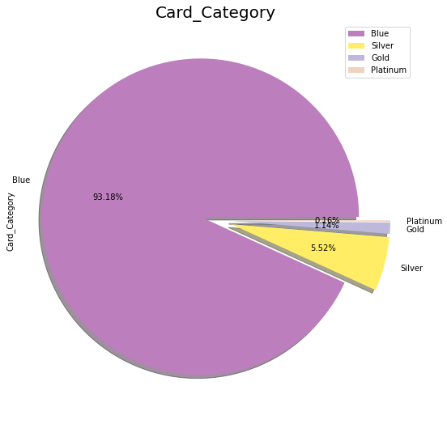
In Income category, There are
Less than $40K in Bank are 39.43%
40K−60K in Bank are 19.94%
80K−120K in Bank are 16.98%
60K−80K in Bank are 15.58%
$120K + in Bank are 8.08%
Card Category, There are
Blue card Customers in Bank are 93.18%
Silver card Customers in Bank are 5.52%
Gold Customers in Bank are 1.14%
Platinum Customers in Bank are 0.16%

Slide 15
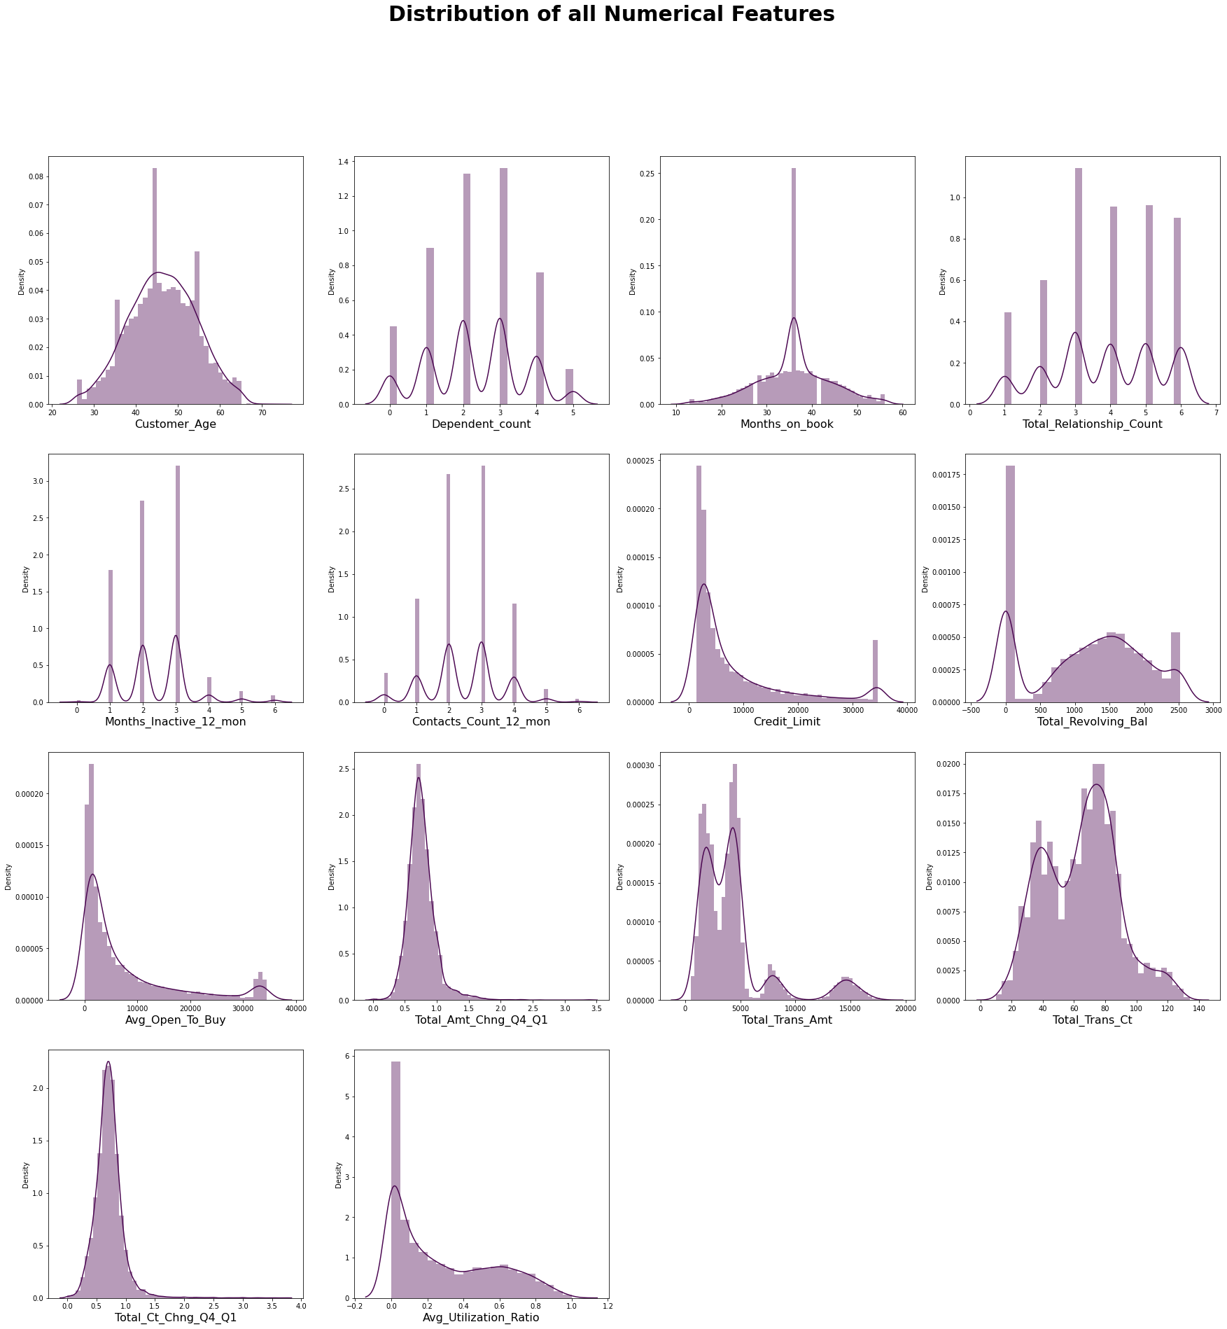
EDA on all numerical Features:
Distribution for all Numerical Features
Conclusion:
from the distributions, we see that most of the distributions are positively skewed.

Slide 16

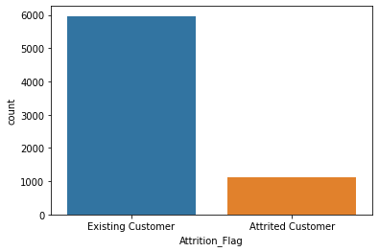
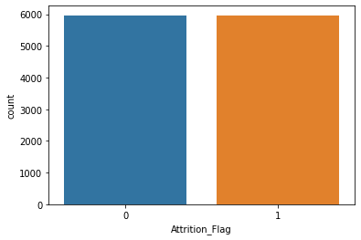
Synthetic Minority Oversampling Technique (SMOTE)
This technique generates synthetic data for the minority class.
SMOTE (Synthetic Minority Oversampling Technique) works by randomly picking a point from the minority class and computing the k-nearest neighbors for this point. The synthetic points are added between the chosen point and its neighbors.
Imbalance Data
Balance Data after apply SMOTE

Slide 17
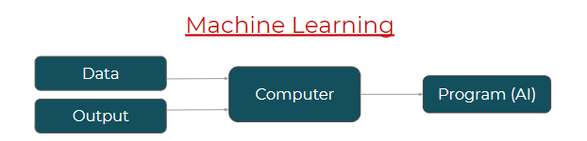
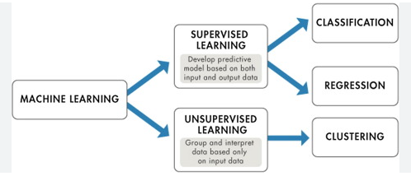
Machine Learning:
Machine Learning is concerned with computer programs that automatically improve their performance through experience.
Classification of Machine Learning:-

Slide 18
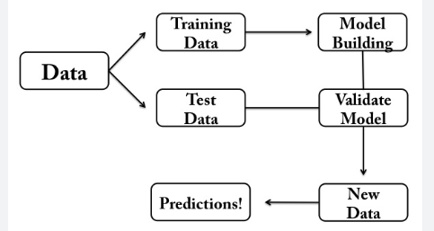
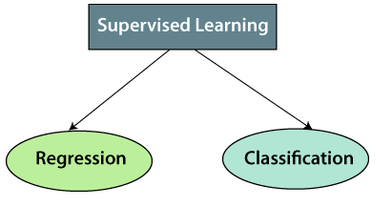
Steps Involved in Supervised Learning:
Types of supervised Machine learning Algorithms:
Churn prediction is typically treated it as a classification problem, classifying a customer as yes/no for churning.

Slide 19
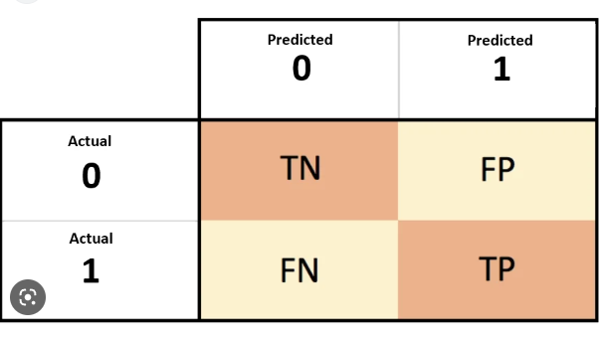
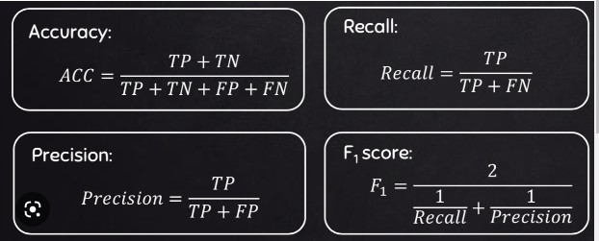
Confusion matrix:
A confusion matrix is a table that is used to define the performance of a classification algorithm
Evaluation metrics for classification models :-
AUC-ROC - The Receiver Operator Characteristic (ROC) curve is a probability curve that plots the TPR against FPR at various threshold values.
The Area Under the Curve (AUC) is the measure of the ability of a classifier to distinguish between classes and is used as a summary of the ROC curve.

Slide 20
In this Project “Bank Churn Prediction”
Target variable is Attrition_Flag which is dependent on all other variable, i.e. other than Attrition_Flag all the variables are independent to each other.
Target variable is categorical in nature and having two class only
Hence we use numerical encoding to convert into numerical form.
{'Attrition_Flag':{'Existing Customer':0,'Attrited Customer':1}}
Also convert categorical value who have few unique values into numerical form.
{'Gender':{"M":1,"F":0},
'Education_Level‘ : {'Graduate': 3,'High School': 1, 'Uneducated':0, 'College':2, 'Post-Graduate':4, 'Doctorate':5},
'Marital_Status‘ : {'Married':1,'Single':0,"Divorced":2},
'Income_Category‘ : {'Less than $40K': 0, '$40K - $60K': 1, '$80K - $120K': 3, '$60K - $80K': 2,'$120K +': 4},
'Card_Category‘ : {'Silver':1,'Blue':0,'Gold':2,'Platinum':3}}

Slide 21
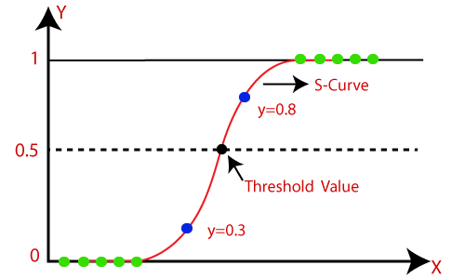
Classification Algorithm:
Logistic Regression:
Logistic regression is a statistical analysis method to predict a binary outcome, such as yes or no, based on prior observations of a data set.
logistic function:
p=exp(wTx)/(1+exp(wTx))
Or in the more commonly seen form:
hw(x)=1/(1+exp(−wTx))
logit function:-log(p/(1−p)) = w0+w1x1,...,wjxj = wTx
where:
w0 is the intercept term, and w1 to wj represents the parameters for all the other features (a total of j features).
By convention of we can assume that x0=1, so that we can re-write the whole thing using the matrix notation wTx.

Slide 22
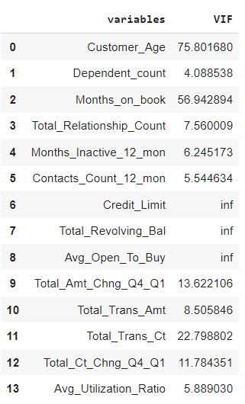
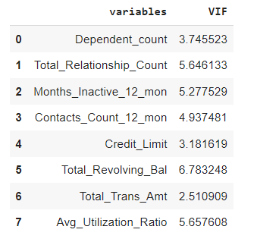
Logistic Regression:
Check for assumptions:
Dependent variable is categorical in nature. Since Attrition_Flag has only two classes Attrited Customer and Existing Customer.
The independent variable should not have multi-collinearity.
Multicollinearity occurs when two or more independent variables are highly correlated with one another.
Detecting Multicollinearity by VIF(Variance Inflation Factors :
Remove the variables which have high VIF.
Small VIF values, VIF < 3, indicate low correlation among variables
The default VIF cutoff value is 5;
However, many sources say that a VIF of less than 10 is acceptable
Hence Independent variable with acceptable VIF Score.

Slide 23
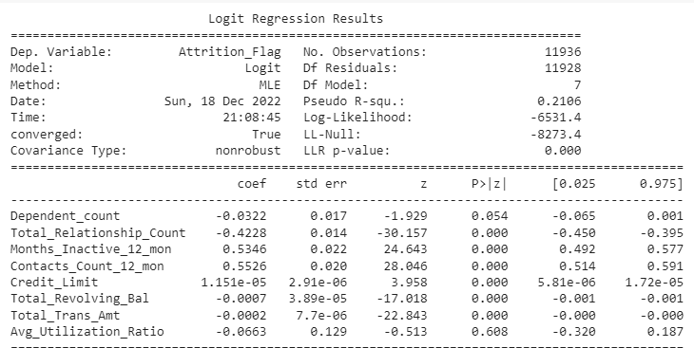

Output Summary:-
Here the p values for the variables 'Total_Relationship_Count', 'Months_Inactive_12_mon', 'Contacts_Count_12_mon', 'Credit_Limit', 'Total_Revolving_Bal', 'Total_Trans_Amt', are 0 which is less than 0.05.
Hence these variables are significant for our model.
MODEL:
log(p/(1−p)) = w0+w1x1,...,wjxj = wTx
log(p/(1−p))=w0 – 0.0322*Dependent_count – 0.4228*Total_Relationship_Count + 0.5346*Months_Inactive_12_mon + 0.5526*Contacts_Count_12_mon + 1.15e-0.5* Credit_limit -0.0007* Total_Revolving_Bal – 0.0002*Total_Trans_Amt – 0.0663*Avg_Utilization_Ratio

Slide 24
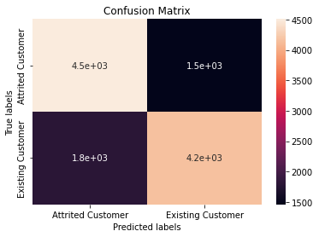
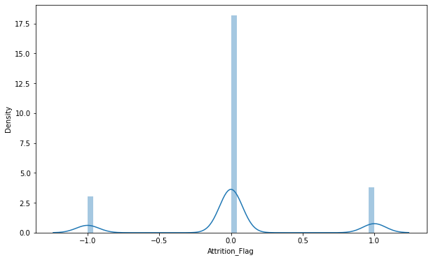
ERROR DISTRIBUTION
accuracy on test data is 0.73
precision on test data is 0.698
recall on test data is 0.74
f1 Score on test data is 0.72
roc_score on test data is 0.73

Slide 25
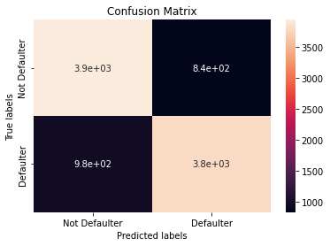
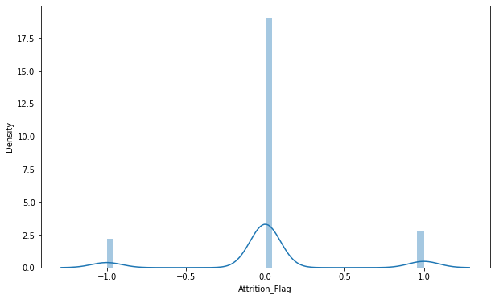
Cross Validation:-
Cross-validation is a technique for evaluating ML models by training several ML models on subsets of the available input data and evaluating them on the complementary subset of the data. Use cross-validation to detect overfitting, i.e., failing to generalize a pattern
GridSearchCV(cv=3, estimator=LogisticRegression(), n_jobs=-1, param_grid={'C': [0.001, 0.01, 0.1, 1, 10, 100, 1000], 'penalty': ['l1', 'l2']}, scoring='accuracy', verbose=3)
accuracy on test data is 0.79
precision on test data is 0.77
recall on test data is 0.81
f1 Score on test data is 0.79
roc_score on test data is 0.79

Slide 26
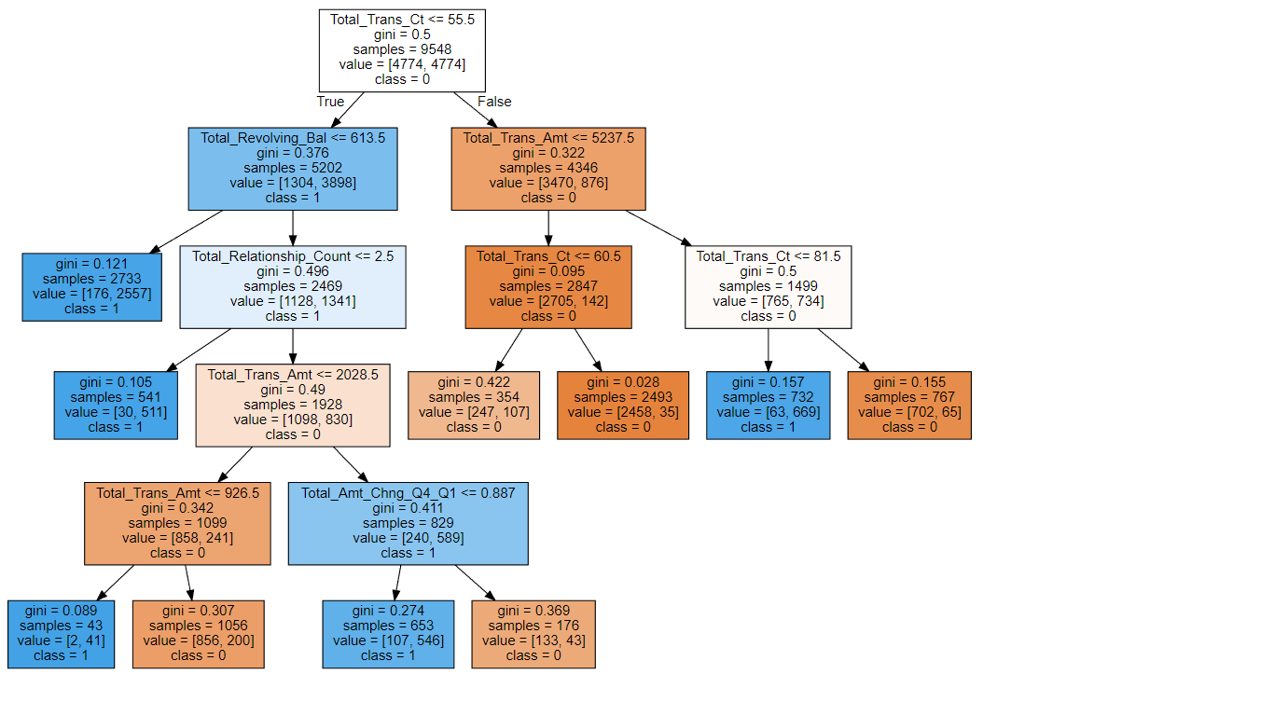
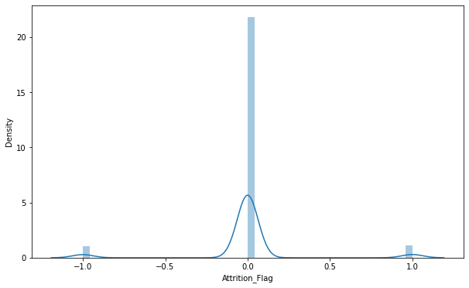
DECISION TREE:-
It is a graphical representation for getting all the possible solutions to a problem/decision based on given conditions.
Error Distribution
accuracy on test data is 0.9087
precision on test data is 0.9704
recall on test data is 0.9101
F1 score on test data is 0.9085
roc_score on test data is 0.9087

Slide 27
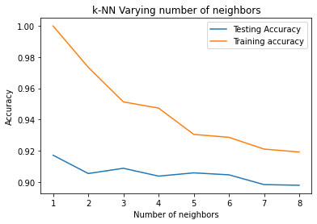
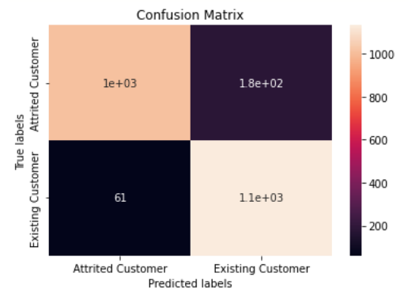
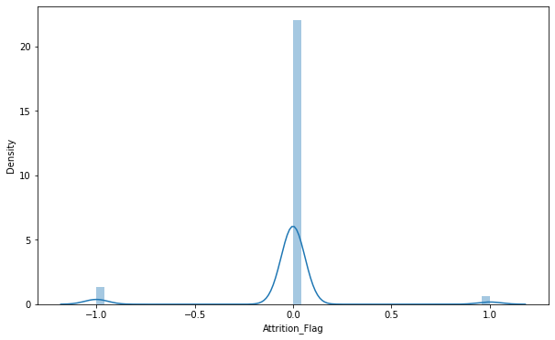
KNN Classifier:-
The k-nearest neighbors classifier (kNN) is a non-parametric supervised machine learning algorithm. It’s distance-based: it classifies objects based on their proximate neighbors’ classes.
Error Distribution
{'n_neighbors': 1}
accuracy on test data is 0.9171
precision on test data is 0.9472
recall on test data is 0.8934
F1 score on test data is 0.919512
roc_score on test data is 0.91861

Slide 28
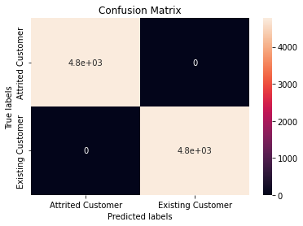
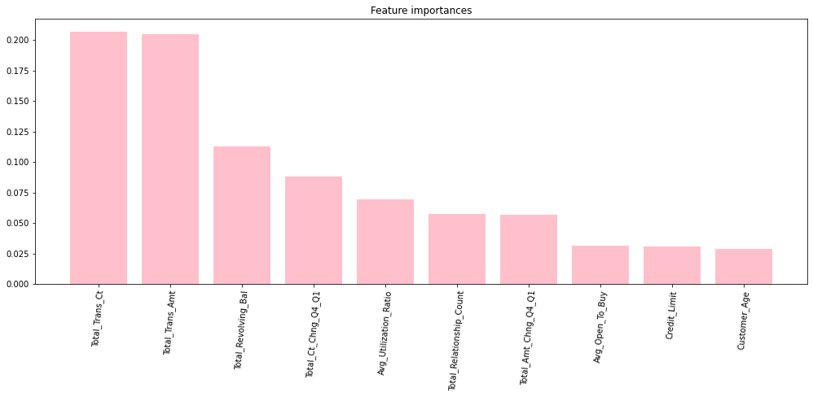
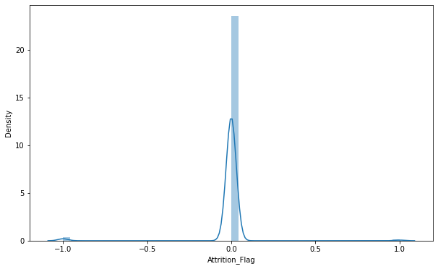
RANDOM FOREST:
Random Forest is a classifier that contains a number of decision trees on various subsets of the given dataset and takes the average to improve the predictive accuracy of that dataset.
Error Distribution
accuracy on test data is 0.77805.
precision on test data is 0.77638.
recall on test data is 0.77899.
F1 score on test data is 0.77768
roc_score on test data is 0.77806

Slide 29
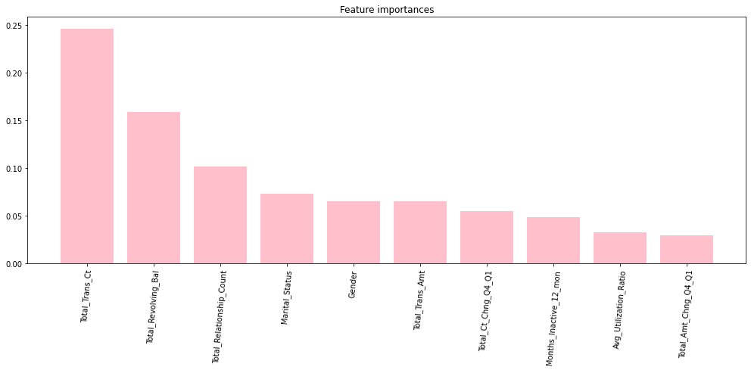
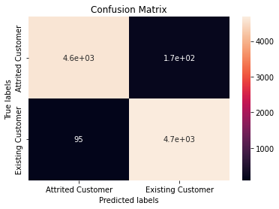
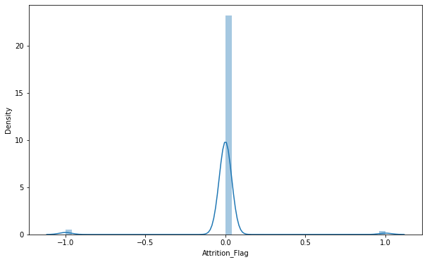
XGBOOST :-
The XGBoost (eXtreme Gradient Boosting) is a popular and efficient open-source implementation of the gradient boosted trees algorithm. Gradient boosting is a supervised learning algorithm that attempts to accurately predict a target variable by combining an ensemble of estimates from a set of simpler and weaker models.
Error Distribution
accuracy on test data is 0.96189
precision on test data is 0.96566
recall on test data is 0.9584
F1 score on test data is 0.9620
roc_score on test data is 0.9619

Slide 30
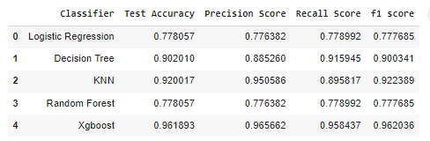
CONCLUSION:-
EVALUATION METRICS SUMMARY FOR ALL CLASSIFIERS:-
Since, We see that XGBoost classifier have highest accuracy, precision, recall and F1 Score,
On the basis of these evaluation metrics, Xgboost is the best classifier amongs all.

Slide 31
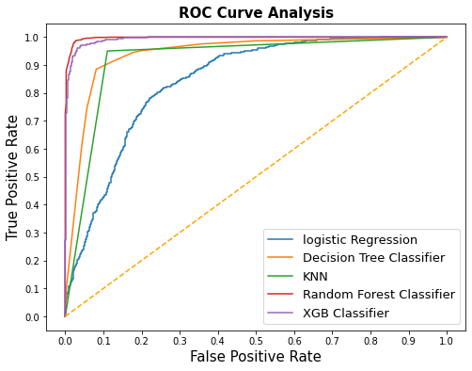
Random Forest and XGboost both are near to 1, thus both classifiers are the best classifiers on the basis of ROC curve.

Slide 32


